Slide 1
Motion Corrected Multishot MRI Reconstruction Using Generative Networks with Sensitivity Encoding
Paper By: Muhammad Usman, Siddique Latif, Muhammad Asim, and Junaid Qadir
Presented By: Craig Kenney

Slide 2
Motion Corrected Multishot MRI Reconstruction
MRI is a well known medical imaging technique, and multi-shot MRI involves taking multiple images over time, to best balance speed and accuracy.
However, there can be issues created by patient motion between consecutive shots, of which there are two types:
Non-rigid Motion – heartbeat, blood moving through the body, eyes.
Rigid Motion – movement of the head, limbs, etc. This is the motion type which causes the most image degradation in MRIs.
This paper aims to correct errors in MRI images of the brain created by rigid motion during scans.

Slide 3
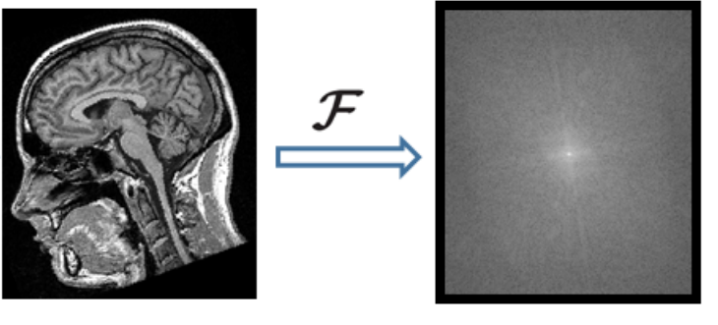
k-space
As a brief aside, the term k-space comes up quite often during this paper, and as it has to do with MRI specifically it deserves some explanation.
The k-space is a representation of an MRI image through it’s spatial frequencies, essentially like light before it is focused by a lens like our eyes.
Each individual pixel of the k-space image has information corresponding to every pixel in the finished MRI image, and the ‘lens’ that creates the useful MRI images we view from the k-space (or vice-versa) is a Fourier Transform.
In this paper, the k-space is used in creating motion-corrupted variants of existing MRI images.

Slide 4
Background & Previous Work – CG-SENSE
K. P. Pruessmann, M. Weiger, P. Börnert, and P. Boesiger, “Advances in sensitivity encoding with arbitrary k-space trajectories,” Magnetic resonance in medicine, vol. 46, no. 4, pp. 638–651, 2001.
M. R. Hestenes and E. Stiefel, Methods of conjugate gradients for solving linear systems. NBS Washington, DC, 1952, vol. 49, no. 1.
K. P. Pruessmann, M. Weiger, M. B. Scheidegger, and P. Boesiger, “Sense: sensitivity encoding for fast MRI,” Magnetic resonance inmedicine, vol. 42, no. 5, pp. 952–962, 1999.
K. L. Wright, J. I. Hamilton, M. A. Griswold, V. Gulani, and N. Seiberlich, “Non-cartesian parallel imaging reconstruction,” Journal of Magnetic Resonance Imaging, vol. 40, no. 5, pp. 1022–1040, 2014.
Conjugate gradient SENSE (called CG-SENSE by this paper) is fairly important background to this paper, as it deals with reconstructing MRI images from the k-space data, and is used in this paper’s experiments. These four papers contribute the mathematical background they use in this paper to quickly reconstruct MRI images.

Slide 5
Background & Previous Work - Suitability
S. Latif, M. Asim, M. Usman, J. Qadir, and R. Rana, “Automating motion correction in multishot MRI using generative adversarial networks,”MED-NIPS, 2018.
This paper’s immediate predecessor, it first examines the GAN that is the focus of this paper. It runs a few preliminary experiments that show using GAN in this way is viable and could compare well to other existing methods of MRI Motion Correction.

Slide 6
Background & Previous Work – Motion Correction
L. Cordero-Grande, R. P. A. Teixeira, E. J. Hughes, J. Hutter, A. N. Price, and J. V. Hajnal, “Sensitivity encoding for aligned multishot magnetic resonance reconstruction,” IEEE Transactions on Computational Imaging, vol. 2, no. 3, pp. 266–280, 2016.
L. Cordero-Grande, E. J. Hughes, J. Hutter, A. N. Price, and J. V. Hajnal, “Three-dimensional motion corrected sensitivity encoding reconstruction for multi-shot multi-slice MRI: Application to neonatal brain imaging,” Magnetic resonance in medicine, vol. 79, no. 3, pp. 1365–1376, 2018.
Cordero et al., as this paper often refers to their work, is this paper’s primary point of comparison for experimental results. They also aim to correct rigid motion errors in MRIs of the brain, though instead of the GAN deep learning method proposed here, they modify the reconstruction equation and rely on solving a forward model that uses motion estimation.

Slide 7
Generative Adversarial Networks
A Generative Adversarial Network (GAN), functions by setting two or more neural networks against each other in training.
In their original design, the generator network attempts to create fake data matching a profile (art, sound, etc.) and the discriminator network attempts to catch these fakes.
Each component trains against the other, getting better at their respective jobs until eventually the generator learns the pattern of the profile completely. From that point on, it can be used to generate new data.
This paper uses a variation called conditional GAN; it takes as input the corrupted MRI images instead of noise, and the goal is to produce a clean image, rather than a completely new image.

Slide 8
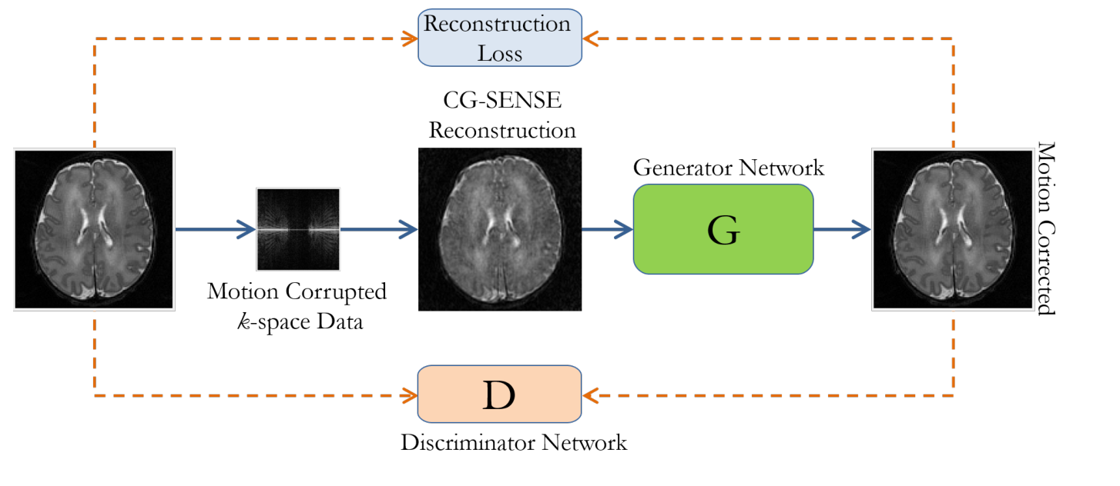
Technique Overview
First, the corrupted k-space data is created and reconstructed into an image using CG-SENSE.
This image is then fed into the GAN Generator network, which uses it to produce a clean MRI image, and both the Generator’s output and the original clean image are fed to the GAN Discriminator, which attempts to distinguish the two.

Slide 9
The GAN Mathematics
A GAN optimization looks like this, the Generator, G, wants to minimize the error the Discriminator, D, finds in its results, while D attempts to maximize.
Their Generator’s loss function takes into account not only the results of the discriminator, but also the correlation to the original image.
λ controls the weight of each loss term, they choose to set it to 0.01

Slide 10
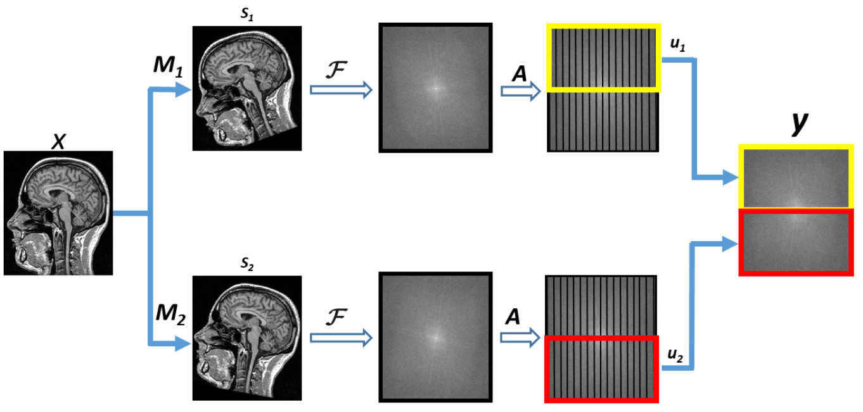
Creating Corrupted Images
They create the corrupted images from clean images using the above process.
This example is creating corruption similar to forward motion, they use parts of the k-spaces of both rotated variants of the original.

Slide 11
Creating Corrupted Images
In this equation, x is the original unmodified image.
They then introduce a collection of M_{s} shots each with some motion added that they then convert into k-space (F), sample (A), and take a segment of each shot (u_{s}).
All of these segments are then combined to create the new, corrupted k-space data, y.

Slide 12
CG-SENSE Reconstruction
This equation represents the conversion from an image, x_{m} to the k-space representation y. E is called the Encoding Matrix. They need to solve this equation for x_{m} to reconstruct an image from the k-space data.
Z is defined to be the inverse of E, as they create the identity when multiplied, so Z can be used to reconstitute y into the image x_{m}.
For more details on the mathematics behind this, see the previously mentioned papers.

Slide 13
Experimental Setup - Data
For their experiment they use a public dataset, specifically T2 FLAIR images from the Brain Tumor Image Segmentation 2015 contest.
This dataset contains 274 scans with 255 slices each.
They use 70% of the scans as training data and the remaining 30% as testing data.
The scans from the dataset are considered motion free, they then corrupt these with the method previously discussed and use them to test their restoration technique.

Slide 14
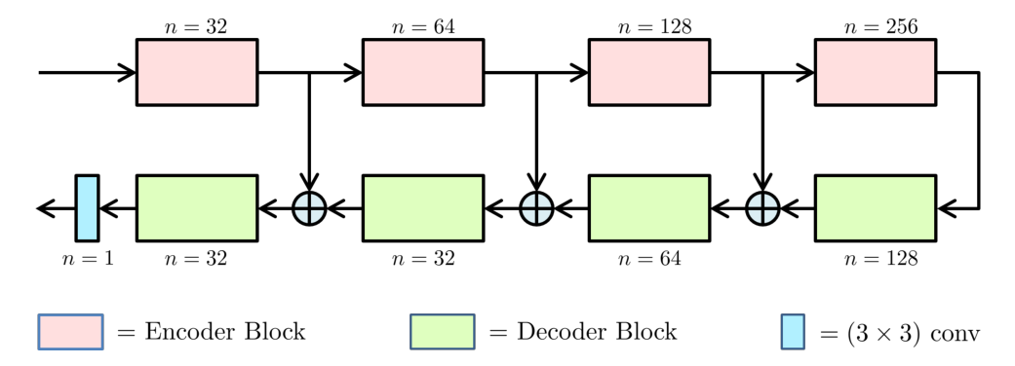
Experimental Setup - Network
This picture represents the Generator network, the input is a corrupted image.
They use a similar model to U-Net, each encoder block is 5 convolution layers, and each decoder block is 5 transposed convolution layers (deconvolution layers).
The Discriminator network is similar, but consists of only the encoder blocks.

Slide 15
Experimental Setup - Training
They pre-train the Generator using the Adam optimizer with learning rate 1*10⁻⁴ and batch size 16.
Then they use the RMSProp optimizer with the same parameters aside from the addition of λ=0.01 now that the Discriminator is involved. For every round of training for the Generator, the Discriminator is put through two.

Slide 16
Results - Measures
AP = Artifact Power, the difference between the original and reconstructed image, averaged over all pixels. (Lower is better)
Peak Signal to Noise Ratio is the ratio between the actual signal and the noise corrupting it. (Higher is better)
Structural Similarity index is difference between the two images calculated on various windows of the image. (Higher is better, scale of 0 to 1)

Slide 17
Results - Effectiveness
Overall performance is fairly good at lower degrees of motion and falls off as the amount of motion increases. However, compared to the previous state-of-the-art method (Cordero et al.), the accuracy is superior at high degrees of motion, and inferior at very low degrees of motion.
Performance is not heavily impacted by number of shots, which is an improvement over Cordero et al. as well.

Slide 18
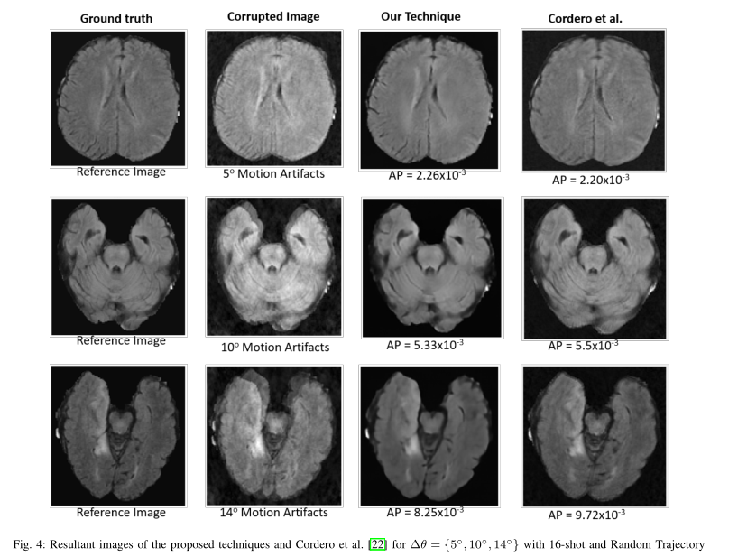
Results - Effectiveness

Slide 19
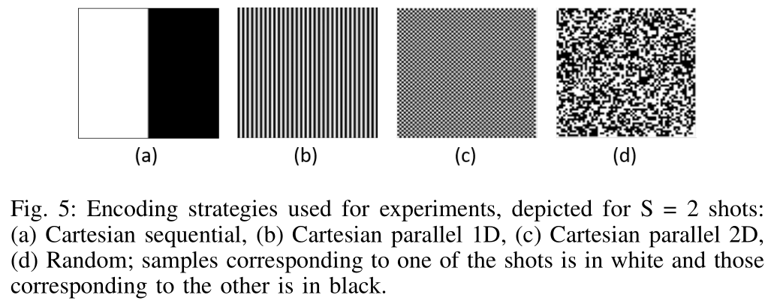
Results - Effectiveness

Slide 20
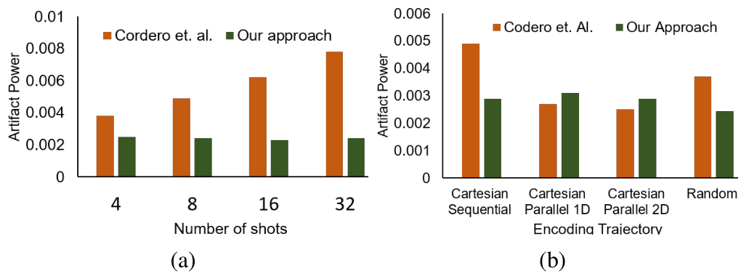
Results - Effectiveness
In addition, increasing the number of shots seems to have little effect on the accuracy of their method, as opposed to Cordero et al.
Differing Encoding Trajectories show less of a clear improvement.

Slide 21
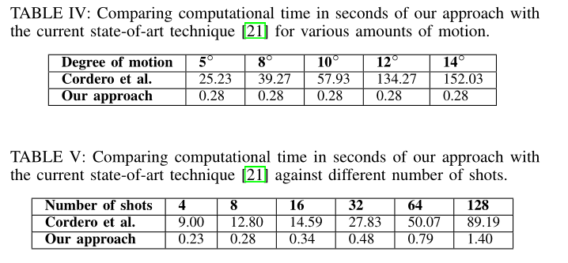
Results - Speed
Speed is where their approach shows the most improvement.
As you can see, it runs over 10x faster in all circumstances, scales slower with shot number than the previous method, and is entirely unaffected by degree of motion, where the previous approach is heavily affected.

Slide 22
Conclusions & Future Work
Their GAN based approach does successfully remove motion artifacts without requiring estimation of motion in either data acquisition or reconstruction.
It also shows a great increase in speed, and responds better to difficult parameters in degrees of motion or number of shots.
As it is a parameter-free technique, it can be applied to any MRI images regardless of how they are created.
In the future, they plan to extend their framework to use the k-space data directly as input to the Generator to create the artifact free image.

Slide 23
Questions?

Slide 24
Sources and References
Original Paper:
M. Usman, S. Latif, M. Asim, and J. Qadir, “Motion Corrected Multishot MRI Reconstruction Using Generative Networks with Sensitivity Encoding” (arXiv:1902.07430)
Background Information:
S. Latif, M. Asim, M. Usman, J. Qadir, and R. Rana, “Automating motion correction in multishot MRI using generative adversarial networks,”MED-NIPS, 2018.
M. R. Hestenes and E. Stiefel, Methods of conjugate gradients for solving linear systems. NBS Washington, DC, 1952, vol. 49, no. 1.
K. P. Pruessmann, M. Weiger, M. B. Scheidegger, and P. Boesiger, “Sense: sensitivity encoding for fast MRI,” Magnetic resonance in medicine, vol. 42, no. 5, pp. 952–962, 1999.
K. P. Pruessmann, M. Weiger, P. Börnert, and P. Boesiger, “Advances in sensitivity encoding with arbitrary k-space trajectories,” Magnetic resonance in medicine, vol. 46, no. 4, pp. 638–651, 2001.
K. L. Wright, J. I. Hamilton, M. A. Griswold, V. Gulani, and N. Seiberlich, “Non-cartesian parallel imaging reconstruction,” Journal of Magnetic Resonance Imaging, vol. 40, no. 5, pp. 1022–1040, 2014.
L. Cordero-Grande, R. P. A. Teixeira, E. J. Hughes, J. Hutter, A. N. Price, and J. V. Hajnal, “Sensitivity encoding for aligned multishot magnetic resonance reconstruction,” IEEE Transactions on Computational Imaging, vol. 2, no. 3, pp. 266–280, 2016.
L. Cordero-Grande, E. J. Hughes, J. Hutter, A. N. Price, and J. V. Hajnal, “Three-dimensional motion corrected sensitivity encoding reconstruction for multi-shot multi-slice MRI: Application to neonatal brain imaging,” Magnetic resonance in medicine, vol. 79, no. 3, pp. 1365–1376, 2018.
mriquestions.com

